Slide 1
Ease of Evolution of an Operating System
A major OS will evolve over time for a number of reasons:
• Hardware upgrades plus new types of hardware:
• New services:
• Fixes:

Slide 2
Serial Processing
These early systems presented two main problems:
• Scheduling:
• Setup time:

Slide 3
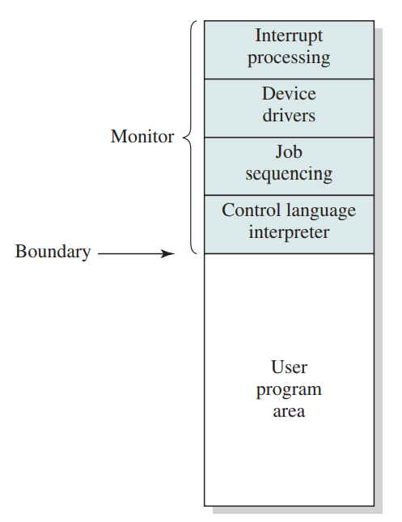
Simple Batch Systems
Monitor point of view
Processor point of view:

Slide 4
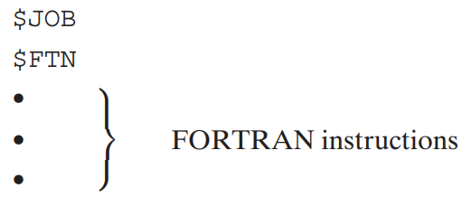
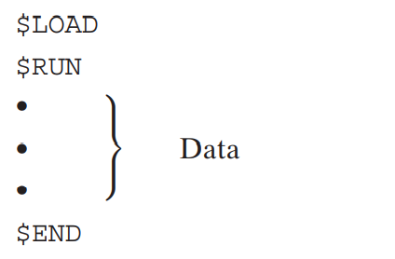
job control language (JCL)

Slide 5
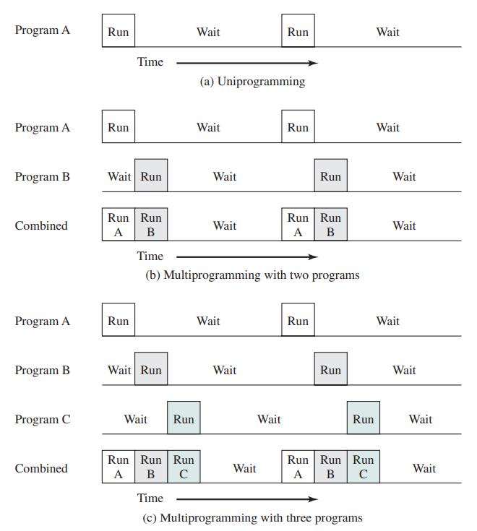
Multiprogrammed Batch Systems

Slide 6
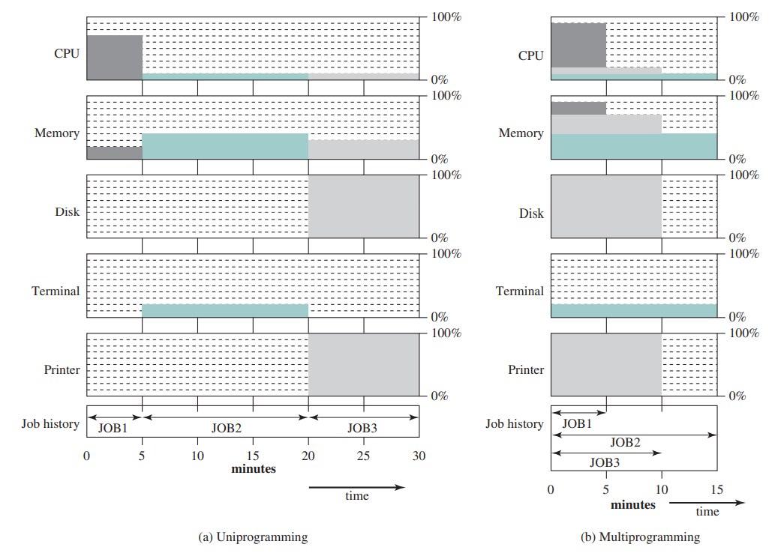
Time-Sharing Systems

